Slide 1
Nebula – voice assistant
SUBMITTED TO: DR. SUSHMA BAHUGUNA
BY
PRADYUMAN PRATAP SINGH - 025

Slide 2
INTRODUCTION
Artificial Intelligence when used with machines, it shows us the capability of thinking like humans. In this, a computer system is designed in such a way that typically requires interaction from human.
Voice recognition software enables hands free use of the applications, lets users to query or command the agent through voice interface. This helps users to have access to the agent while performing other tasks and thus enhances value of the system itself.
TECHNOLOGY USED
Python
IDE – VS Code
Speech recognition is the Alexa, Siri, etc. In Python there is an API called Speech Recognition which allows us to convert speech into text. It was an interesting task to make my own assistant. It became easier to send emails without typing any word, Searching on Google without opening the browser, and performing many other daily tasks like playing music.

Slide 3
Libraries
pyttsx3
datetime
speech_recognition
wikipedia
smtplib
webbrowser
os
pyautogui
psutil
pyjokes
request

Slide 4
Features
Can help to do lot many things like..
can tell you the current time and date,
can tell you the current weather,
can tell you battery and cpu usage,
can create the reminder list,
can take screenshots,
can play songs.
can tell you your IP.
can send email to your boss or family or your friend,
can shut down or logout or hibernate your system,
can tell you non funny jokes,
can open any website,
can search the thing on wikipedia,
can change my voice from male to female and vice-versa

Slide 5
System DIAGRAMs

Slide 6
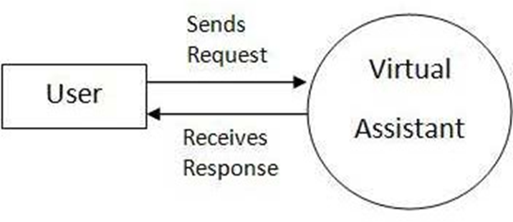
Data Flow Diagram

Slide 7
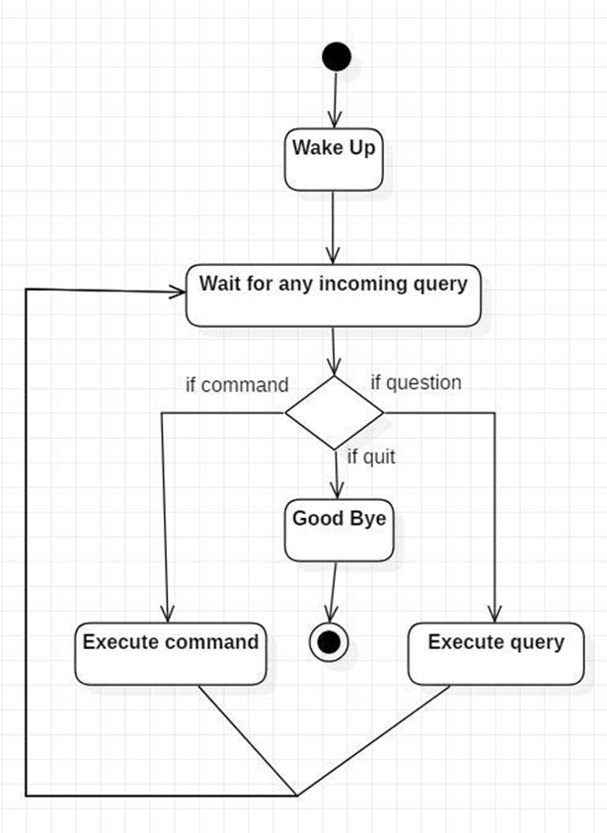
Activity Diagram

Slide 8
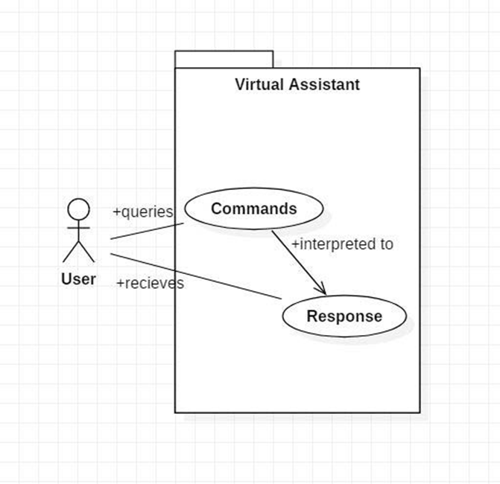
Use Case Diagram

Slide 9
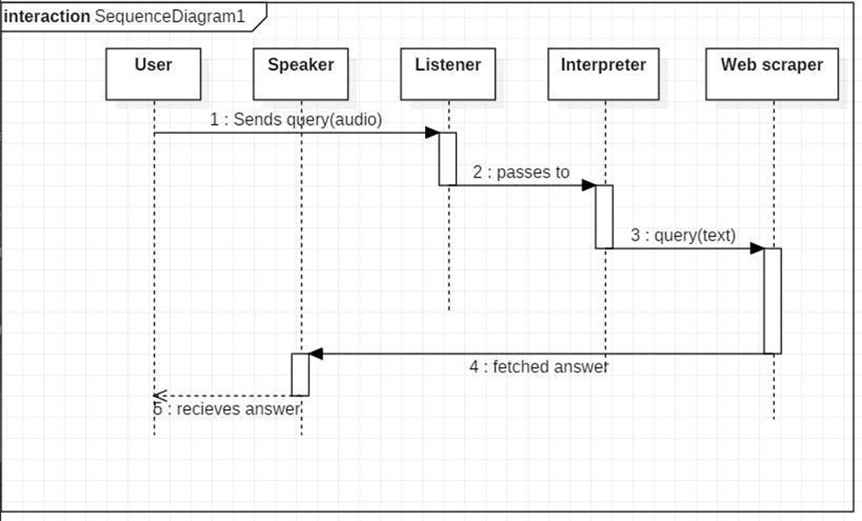
Sequence Diagram query response

Slide 10
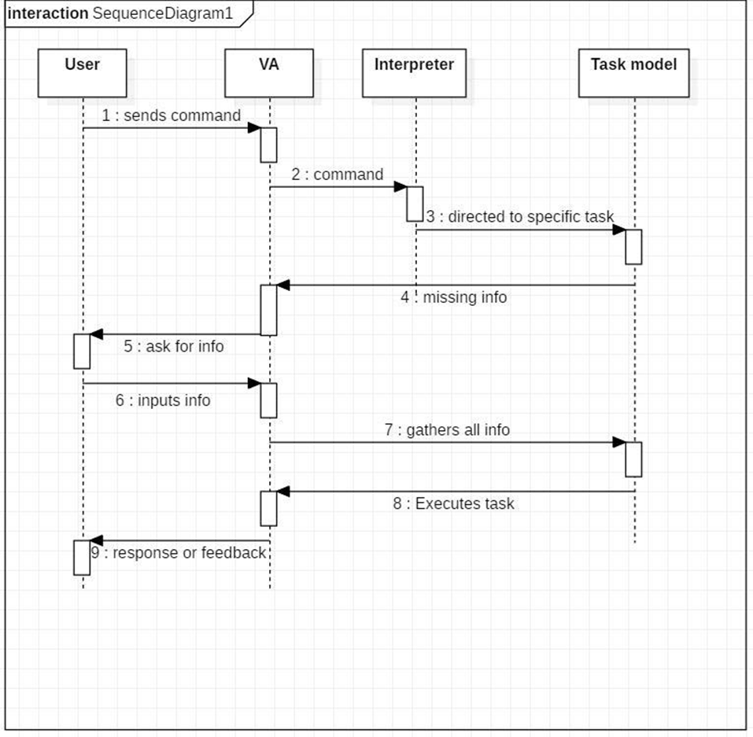
Sequence Diagram Task Execution

Slide 11
PROJECT Execution SLIDES

Slide 12
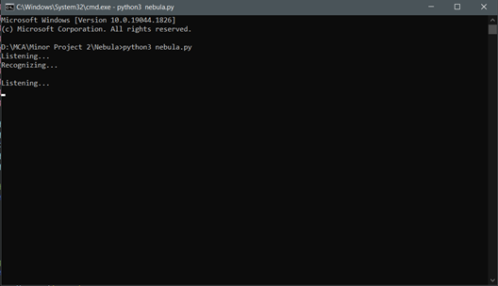
First nebula will greet you according to time and starts taking command while showing “ listening “ on the screen

Slide 13
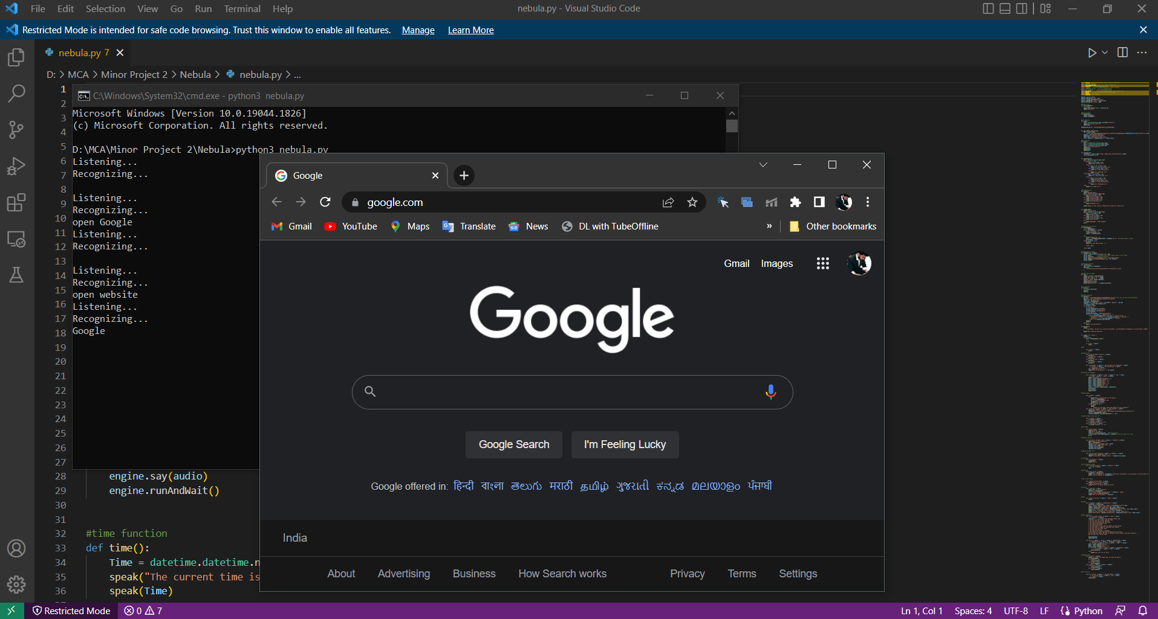

Slide 14
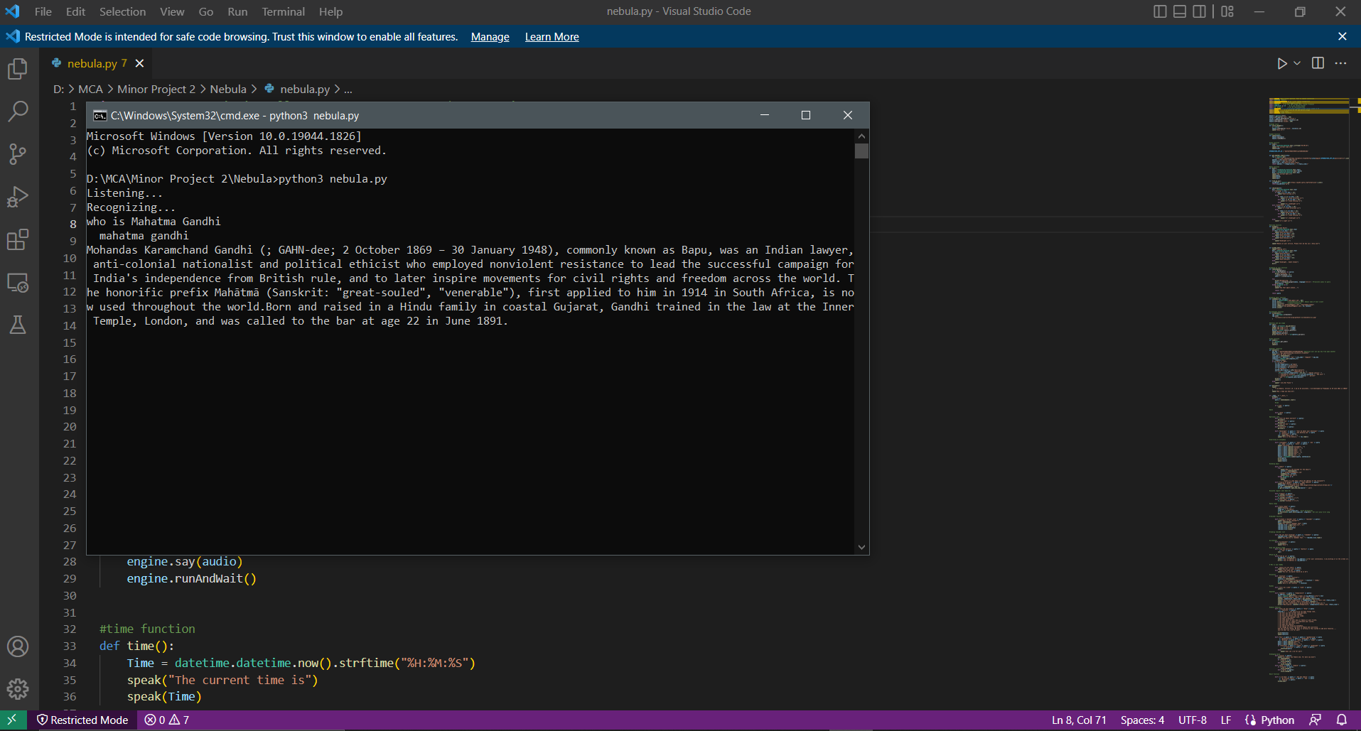

Slide 15
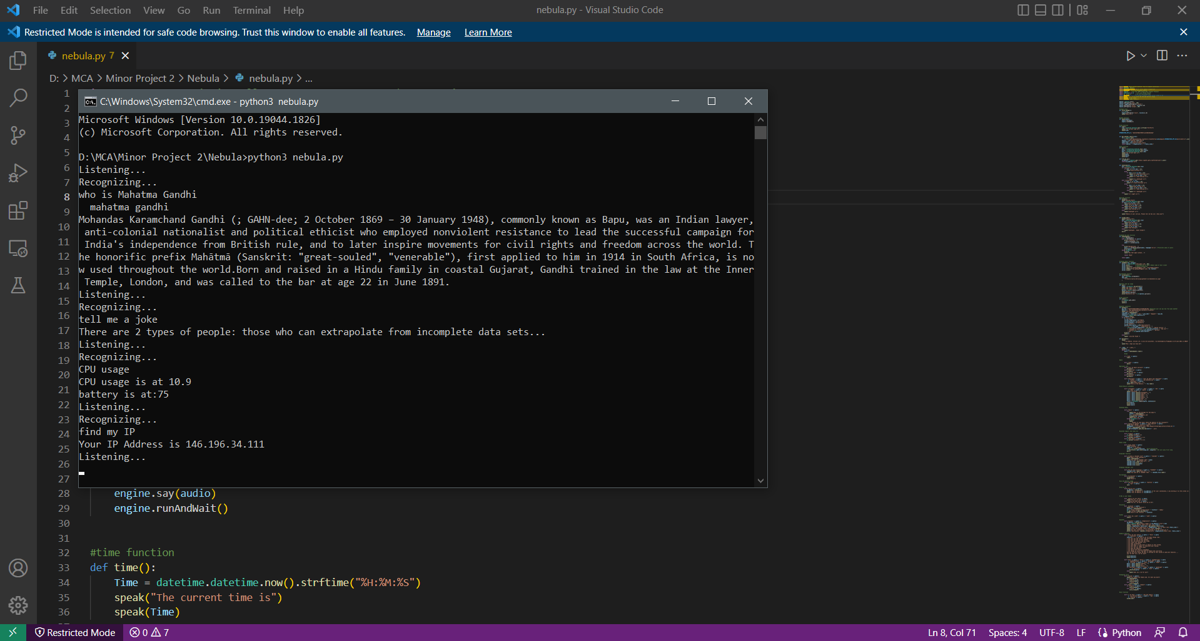

Slide 16
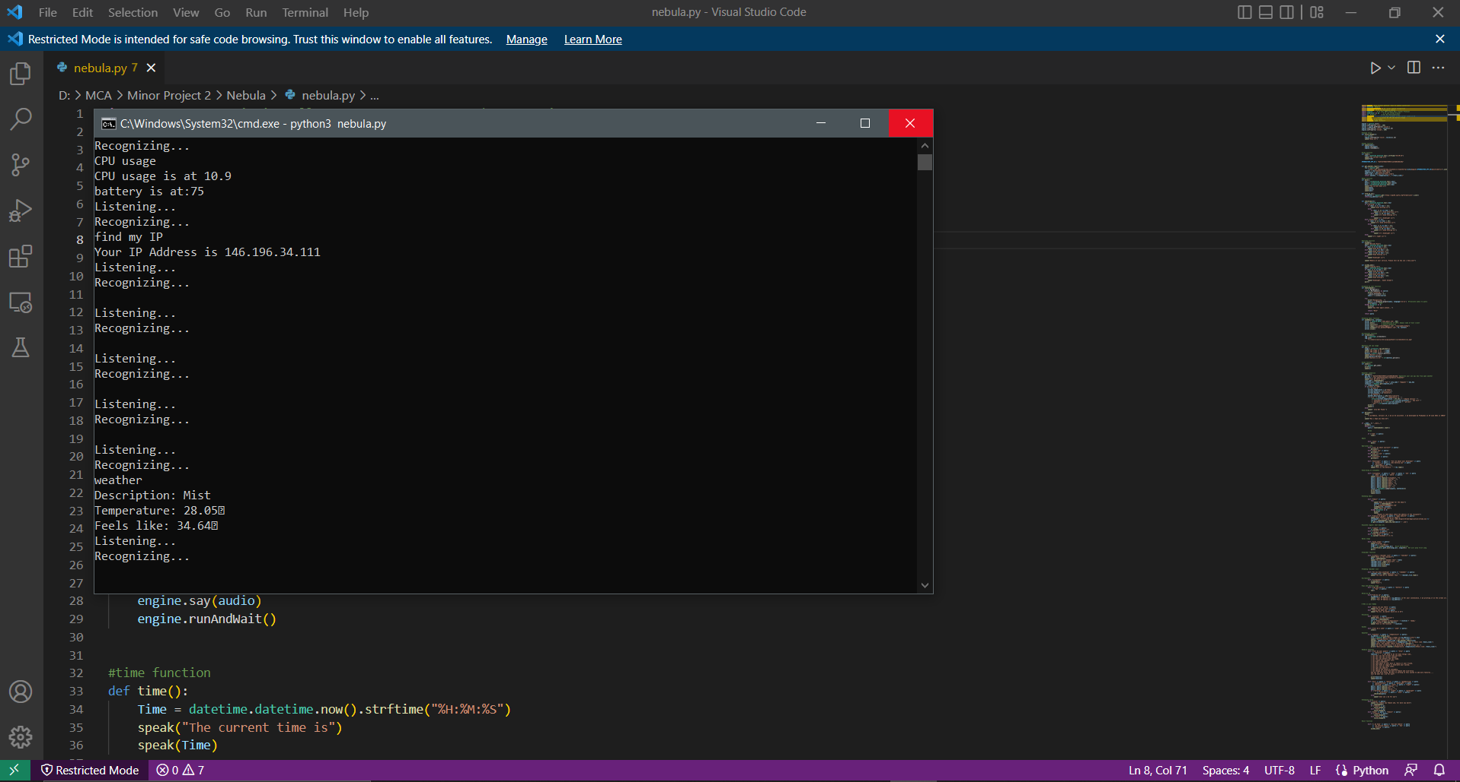

Slide 17
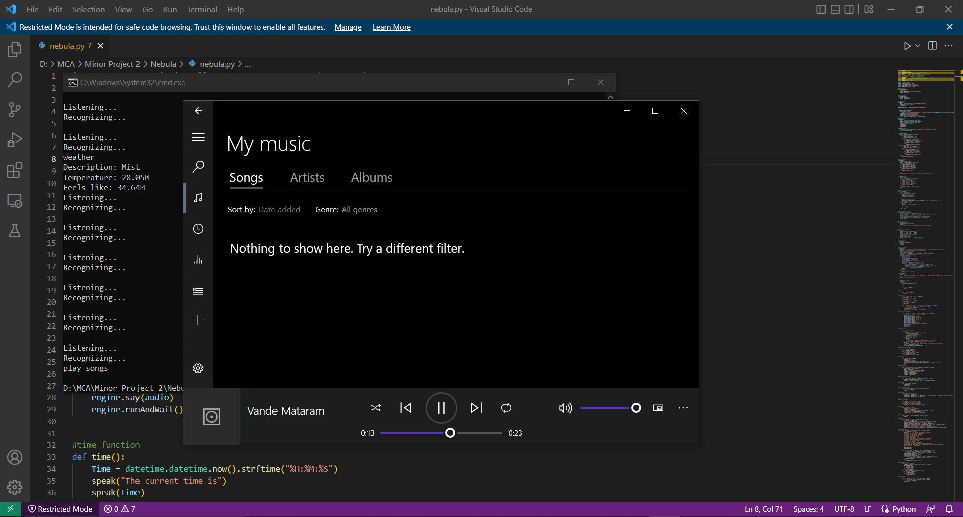

Slide 18
Conclusion
Nebula is a very helpful voice assistant without any doubt as it saves time of the user by
conversational interactions, its effectiveness and efficiency. But while working on this project, there were some
limitations encountered and also realized some scope of enhancement in the future which are mentioned below:
LIMITATIONS
Security is somewhere an issue, there is no voice command encryption in this project.
Background voice can interfere
Misinterpretation because of accents and may cause inaccurate results.
NEBULA cannot be called externally anytime like other traditional assistants like Google Assistant can be called just by saying, “Ok Google!”
SCOPE FOR FUTURE WORK
Give a user interface to it .
Make NEBULA to learn more on its own and develop a new skill in it.
NEBULA android app can also be developed.
Make more Nebula voice terminals.
Voice commands can be encrypted to maintain security.

Slide 19
THANK YOU

